Slide 1
Analysis of fast-food restaurants along US States
Project 2 – Group 2 – US Supersize me !!!
Gregory Gibbs | gregorysmithgibbs@gmail.com
Adam Burstyn | adam.burstyn@gmail.com
Ignacio Domaica | idomaica@gmail.com
Jason Amaya | JasonAmaya53@yahoo.com

Slide 2
AGENDA
PROJECT DESCRIPTION
PROJECT REQUIREMENTS
SOURCES
DIAGRAM (Technologies, Data, Programs)
FLASK Routes:
Visualization
JSON
ETL → MongoDB
DASHBOARD SOLUTION DETAIL

Slide 3


Project Description
Provide a dashboard analysis of fast-food restaurants nationally and across USA states and locations
Locate them geospatially (states and cities / towns)
Filter them by states

Slide 4
AGENDA
PROJECT DESCRIPTION
PROJECT REQUIREMENTS
SOURCES
DIAGRAM (Technologies, Data, Programs)
ETL → MongoDB
FLASK Routes:
Visualization
JSON
DASHBOARD SOLUTION DETAIL

Slide 5

Specific project requirements fulfillment
Your project must be powered by a data set with at least 100 records.
Your visualization must include a Python Flask – powered API, HTML/CSS, JavaScript, and at least one database (SQL, MongoDB, SQLite, etc)
Your project should fall into one of the below 4 tracks:
A custom “creative” D3.js project (i.e. a nonstandard graph or chart)
A combination of web scraping and Leaflet or Plotly
A dashboard page with multiple charts that update from the same data
A “thick” server that performs multiple manipulations on data in a database prior to visualization (must be approved)
Your project must include some level of user-driven interaction (e.g. menus, dropdowns, textboxes).
Your final visualization should ideally include at least 3 views.

Slide 6



Slide 7
BACK UP
7

Slide 8
AGENDA
PROJECT DESCRIPTION
PROJECT REQUIREMENTS
SOURCES
DIAGRAM (Technologies, Data, Programs)
ETL → MongoDB
FLASK Routes:
Visualization
JSON
DASHBOARD SOLUTION DETAIL

Slide 9
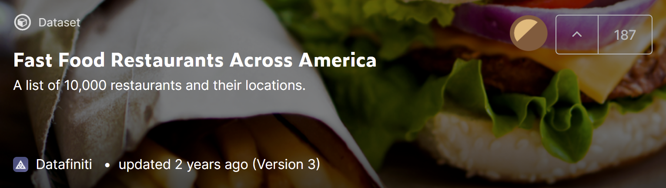
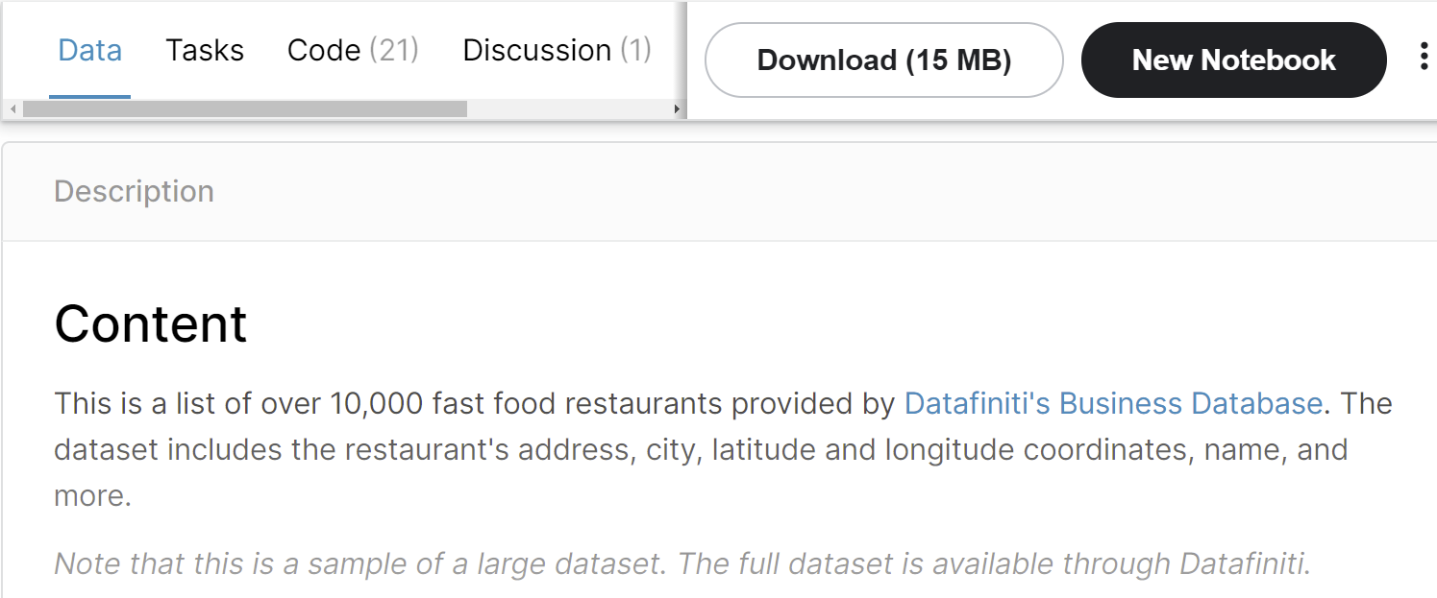
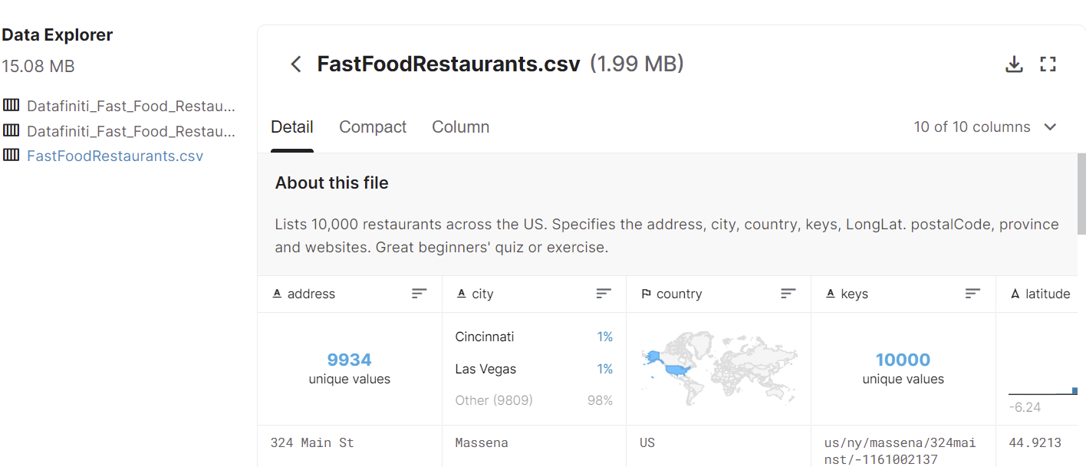
SOURCES
Datasets used obtained from
Kaggle: Fast Food Restaurants Across America
https://www.kaggle.com/datafiniti/fast-food-restaurants?select=FastFoodRestaurants.csv

Slide 10
AGENDA
PROJECT DESCRIPTION
PROJECT REQUIREMENTS
SOURCES
DIAGRAM (Technologies, Data, Programs)
FLASK Routes:
Visualization
JSON
ETL → MongoDB
DASHBOARD SOLUTION DETAIL

Slide 11
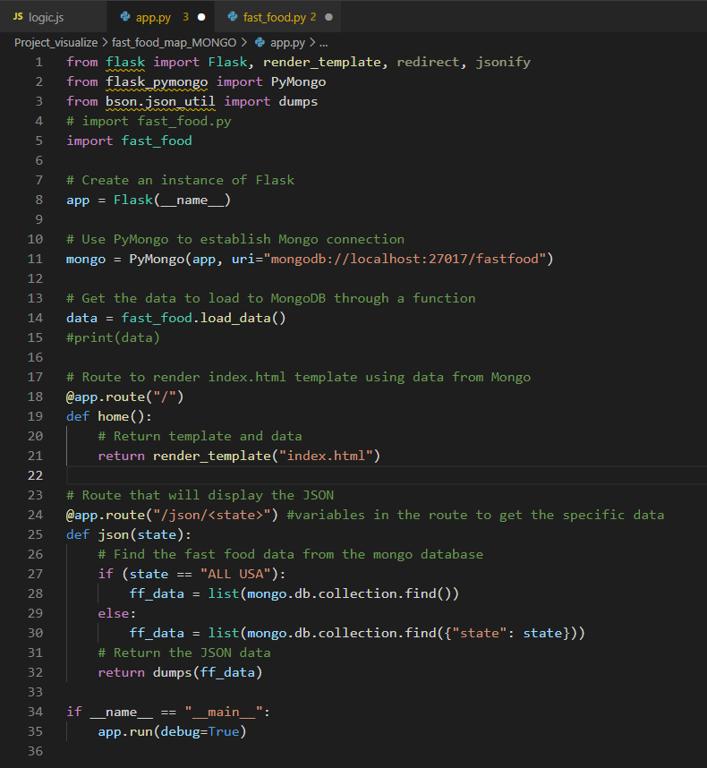
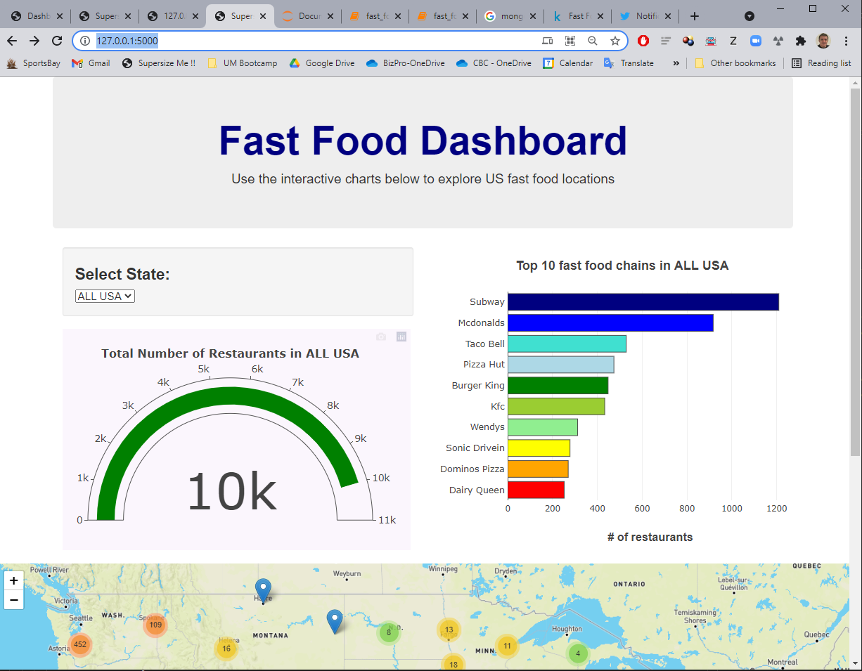
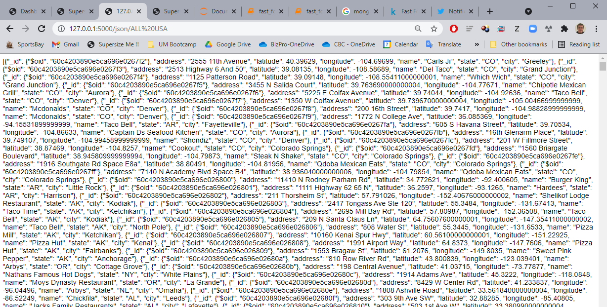
app.py FLASK detail
1st route
2nd route

Slide 12
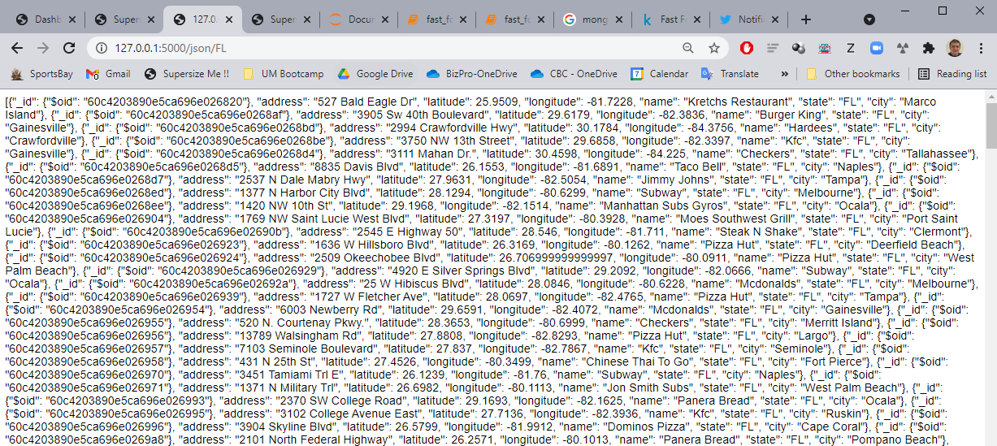
app.py FLASK detail. /JSON/FL for a specific state selected

Slide 13



DIAGRAM. Technologies / Data / Programs
1
2
Data
Development
fast_food.ipynb
MongoDB
db = fastfood
collection = collection
restaurants.csv
@app.route("/") http://127.0.0.1:5000/
3
Route 1:
“index.html”
→ Dashboard
“logic.js”
Flask
app.py
@app.route("/json/<state>") http://127.0.0.1:5000/json/USA
Route 2:
loads data from MongoDB and displays it on the webpage
fast_food.py

Slide 14
DIAGRAM. Technologies / Data / Programs
1
2
Data
Development
fast_food.ipynb
MongoDB
db = fastfood
collection = collection
restaurants.csv
@app.route("/") http://127.0.0.1:5000/
3
Route 1:
“index.html”
→ Dashboard
“logic.js”
Flask
app.py
@app.route("/json/<state>") http://127.0.0.1:5000/json/USA
Route 2:
loads data from MongoDB and displays it on the webpage
fast_food.py

Slide 15
AGENDA
PROJECT DESCRIPTION
PROJECT REQUIREMENTS
SOURCES
DIAGRAM (Technologies, Data, Programs)
FLASK Routes:
Visualization
JSON
ETL → MongoDB
DASHBOARD SOLUTION DETAIL

Slide 16
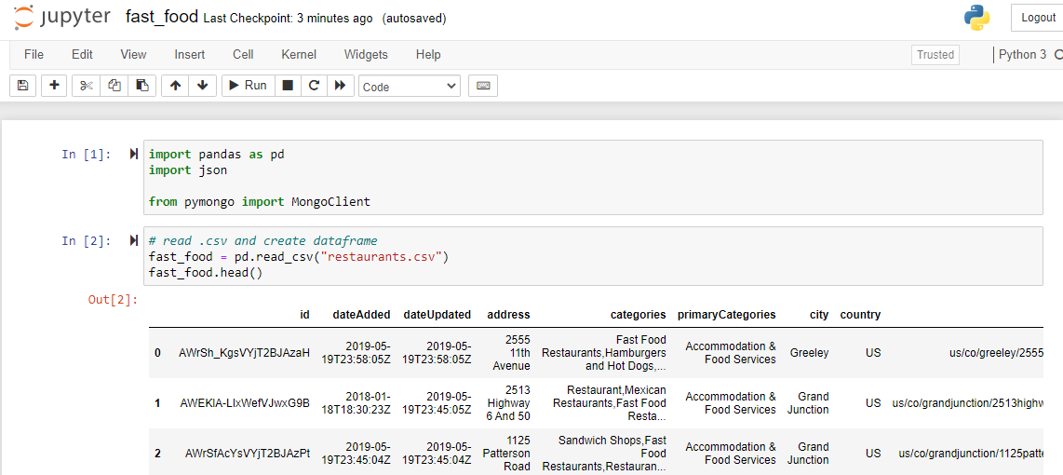
ETL EXTRACT fast_food.ipynb

Slide 17
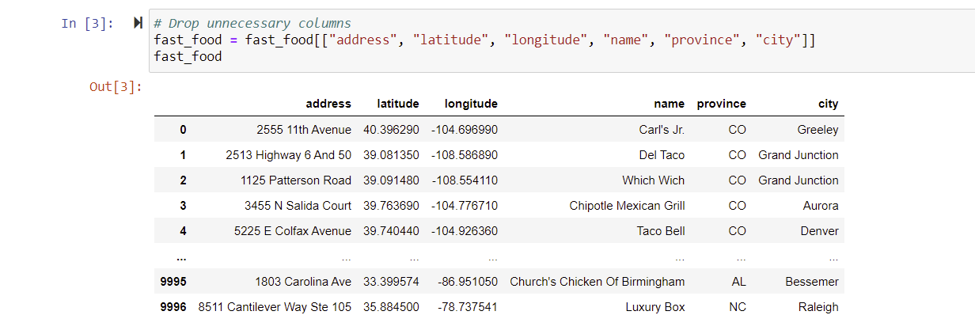
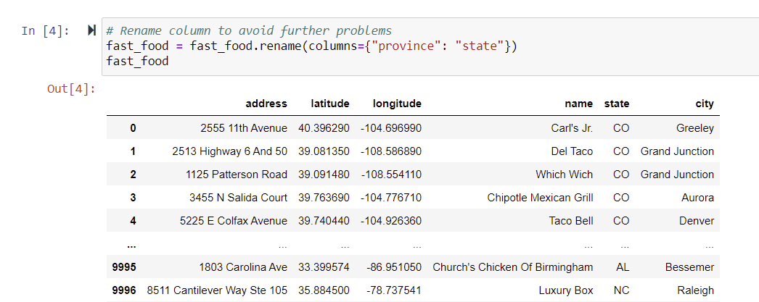
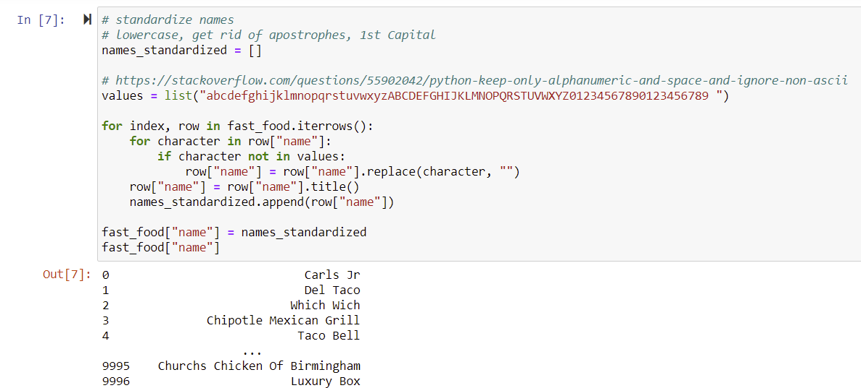
ETL TRANSFORM (2) fast_food.ipynb

Slide 18
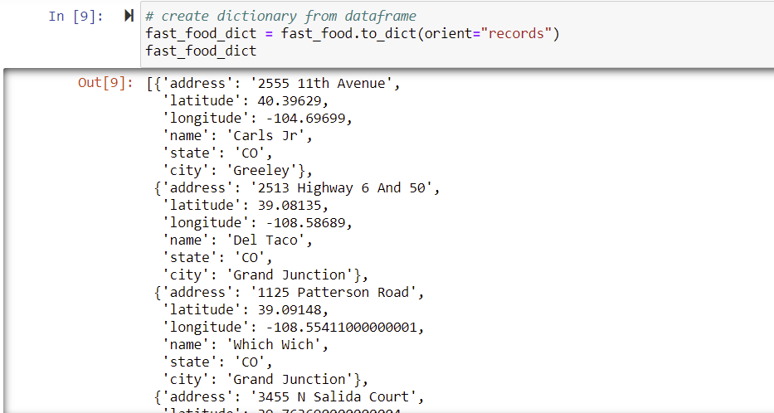
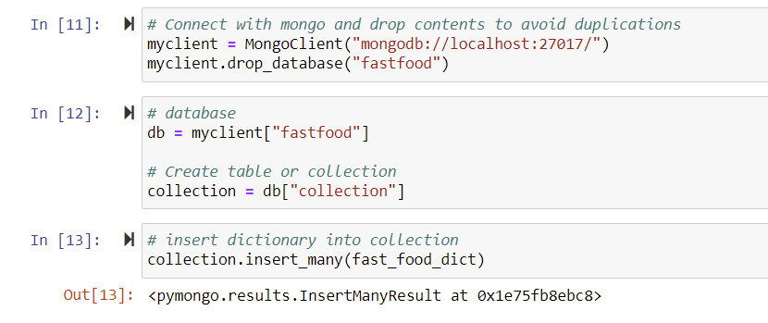
ETL LOAD → MongoDB (3) fast_food.ipynb

Slide 19
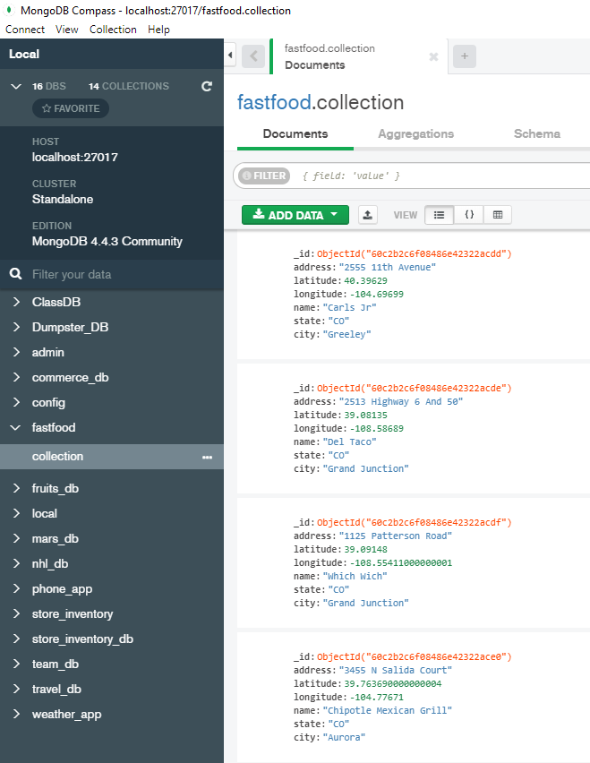
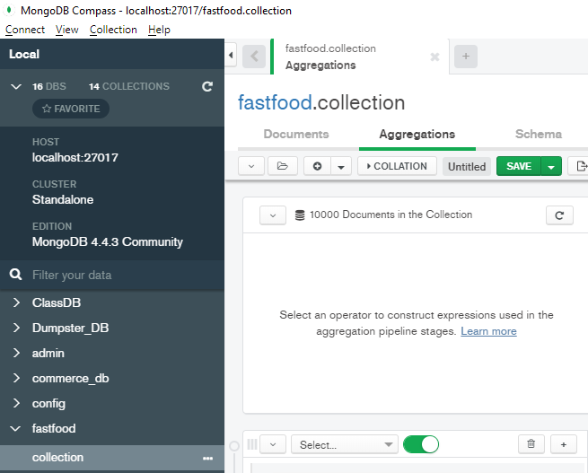
ETL LOAD → MongoDB (4) fast_food.ipynb
Database and collection created in MongoDB

Slide 20
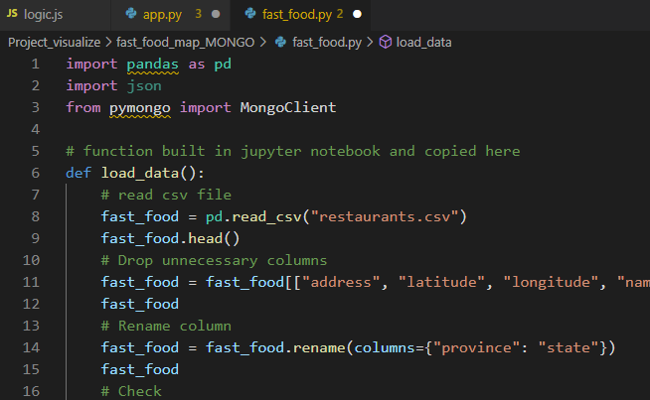
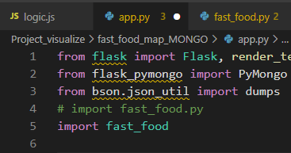
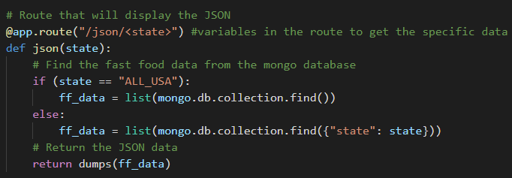
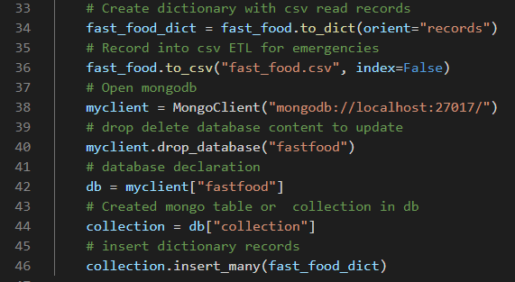
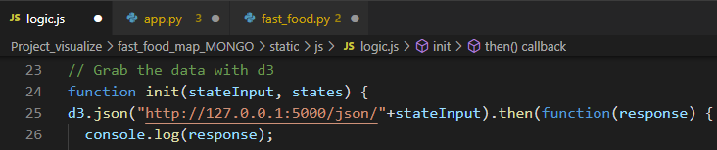
Relations / Concatenation of programs within Flask
1
2
“app.py” runs Flask calls program “fast_food.py”
3
“fast_food.py” reproduces previous jupyter source code to read .csv and creates db and collection @mongoDB
“logic.js” invoked by “index.html” reading json produced by 2nd flask route

Slide 21
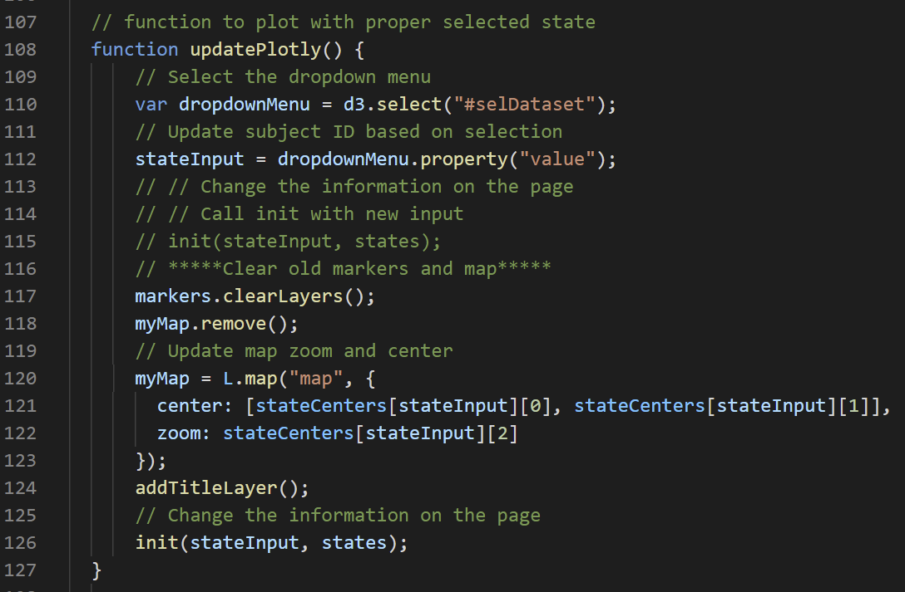
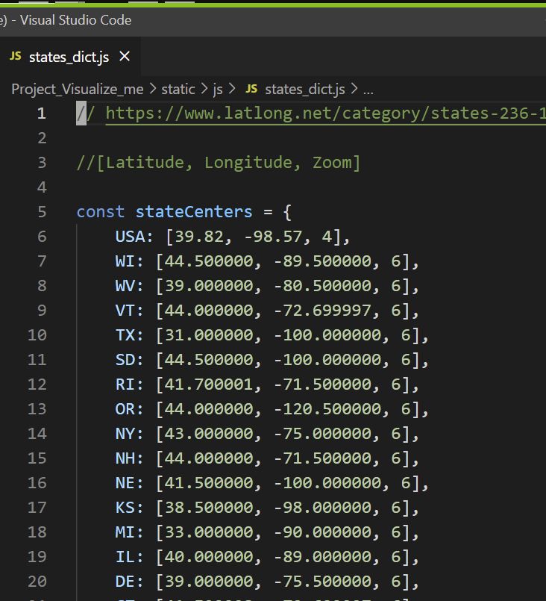
Detail of update plotly function within ‘logic.js’ program

Slide 22
AGENDA
PROJECT DESCRIPTION
PROJECT REQUIREMENTS
SOURCES
DIAGRAM (Technologies, Data, Programs)
ETL → MongoDB
FLASK Routes:
Visualization
JSON
DASHBOARD SOLUTION DETAIL

Slide 23
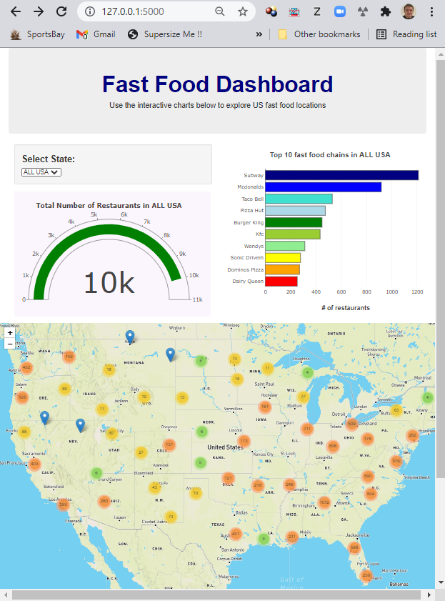
index.html. Dashboard solution detail. GENERAL VIEW. Structure
Jumbo container
Dropdown menu
BAR graph
GAUGE indicator
Mapbox interactive map with markers

Slide 24
index.html. Dashboard solution detail. GENERAL VIEW

Slide 25
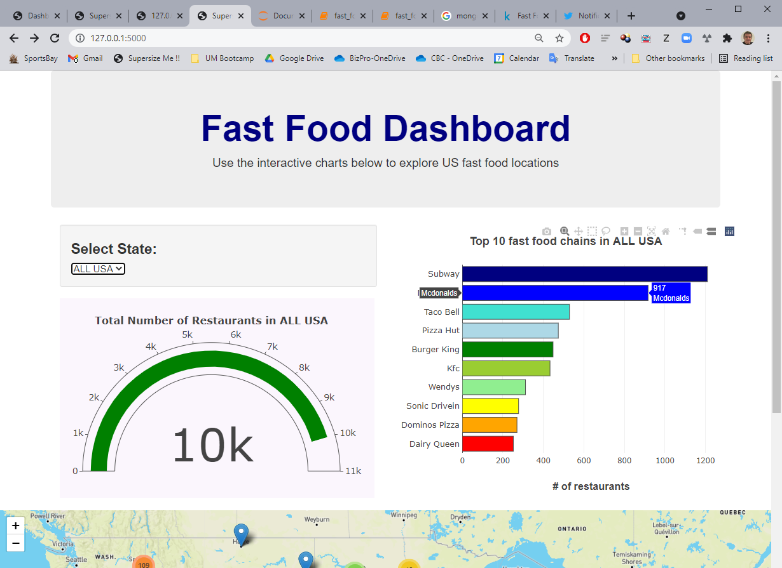
index.html. Dashboard solution detail. GENERAL VIEW. Hover over bar

Slide 26
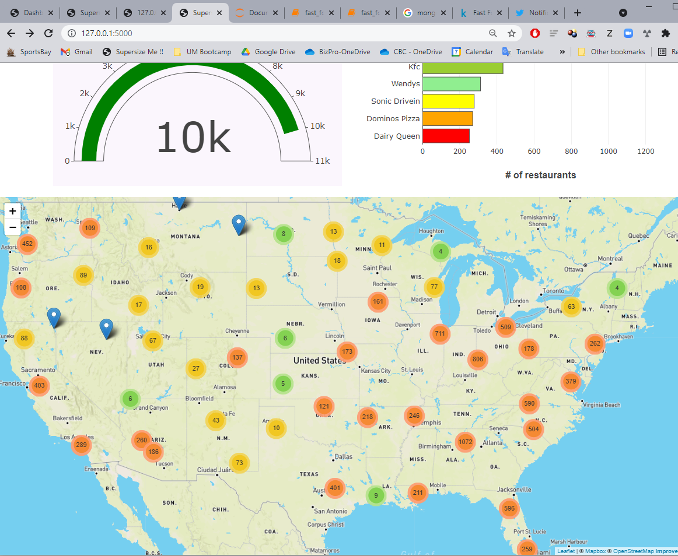
index.html. Dashboard solution detail. GENERAL VIEW. Lower part interactive drill down map
Also serves as “heat map”.
Changing color by density or
concentration

Slide 27
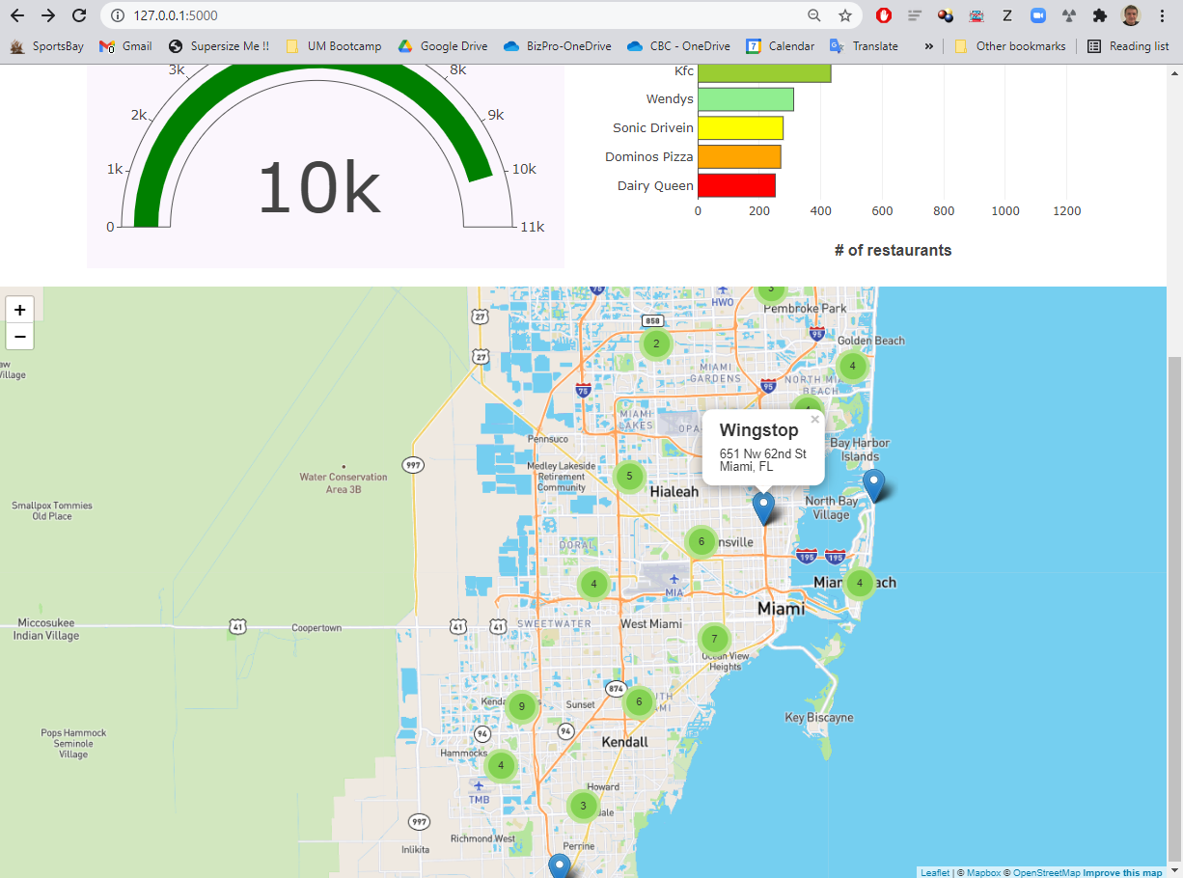
index.html. Dashboard solution detail. GENERAL VIEW. Zoom detail and tipbox

Slide 28
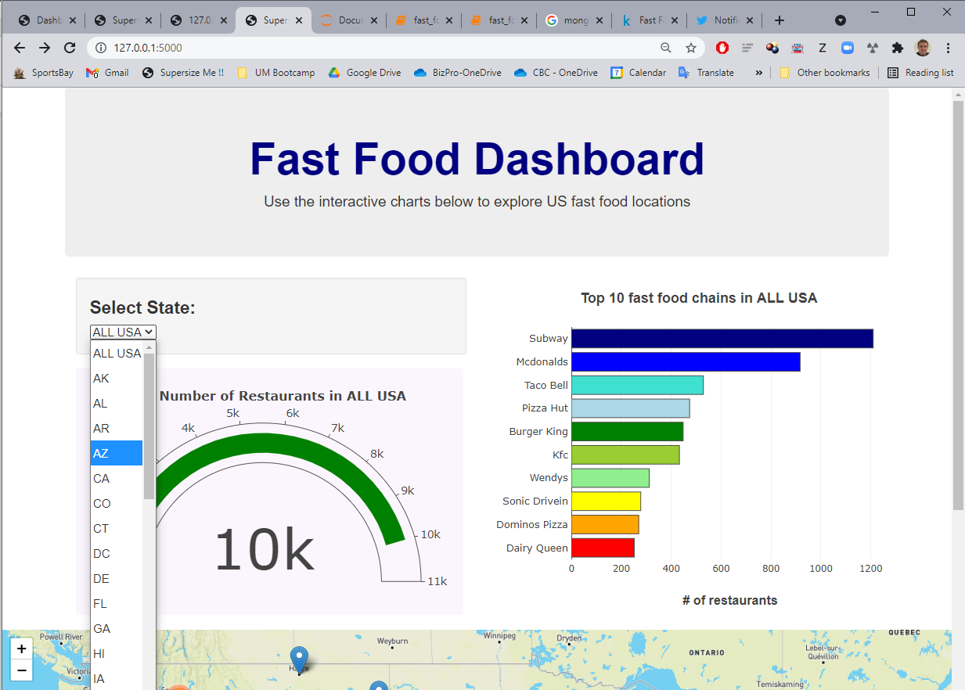
index.html. Dashboard solution detail. DROPDOWN SELECTION

Slide 29
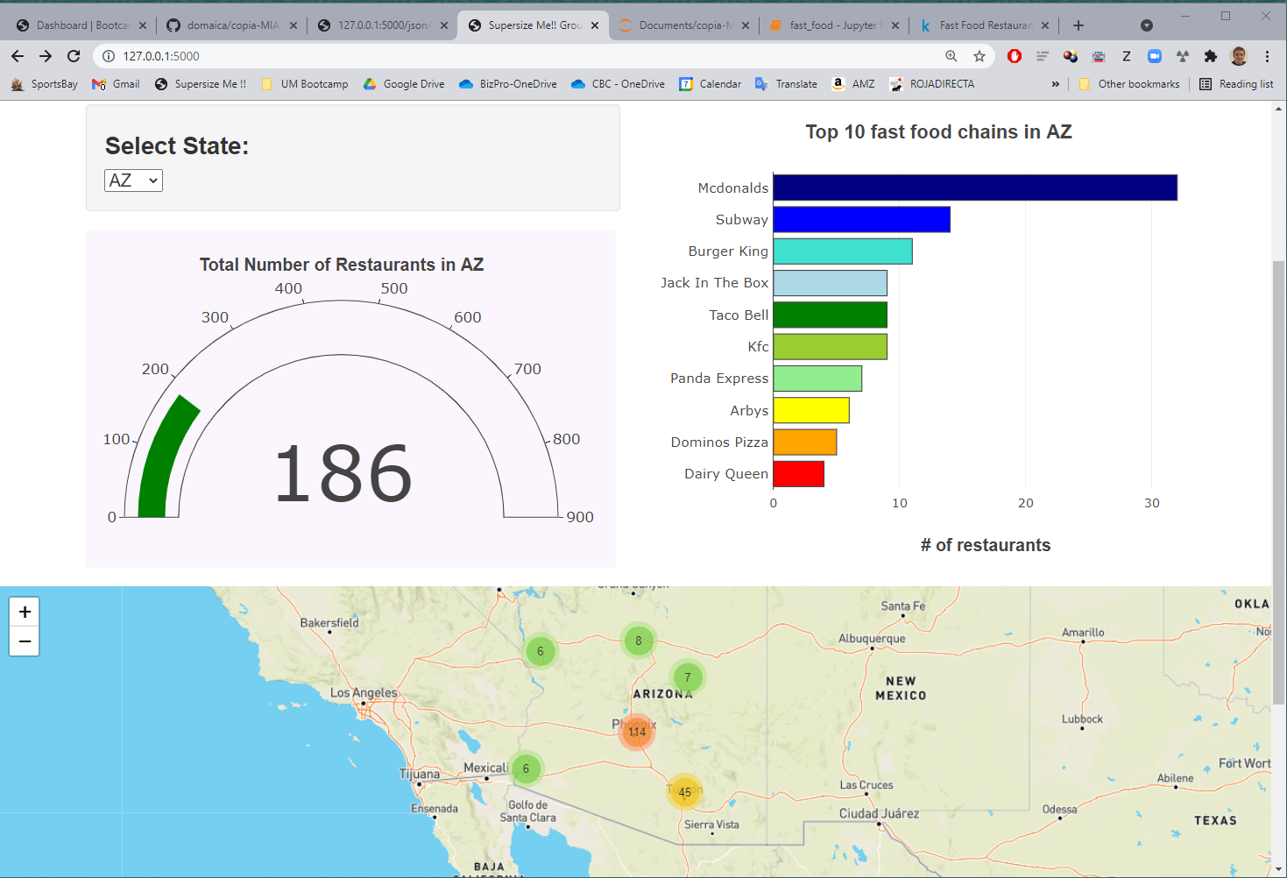
index.html. Dashboard solution detail. DROPDOWN SELECTION. Refreshed results gauge, bars & MAPBOX

